Slide 1
Art
Art is a diverse range of human activities in creating visual, auditory or performing artifacts, Expressing the author’s imaginative, conceptual ideas
Art is anything done by man with creative perception. This needs excellent skills and techniques with in tones of emotion
This inclueds writing, acting, dancing, conposing, directing, singing, playing musical instruments, painting, cooking, architecting etc.

Slide 2
Types of Arts
There are many types of arts
Visual Arts
Performing Arts
Decorative Arts
Literary Arts
Applied Arts
Media Arts
Purpose of arts
Information
Education
Entertainment

Slide 3
BASIC CONCEPT OF INDIAN ART
Indian art comprises various art forms like paintings like patta chitra, madhubani, ceramics, sculpture and textile arts such as woven silk. Indian art is acknowledged for its immense sense of design, which can be seen in both modern and traditional forms.
Indian art can trace its origins to antiquity. It has been influenced by cultural as well as religious elements such as Hinduism, Sikhism, Buddhism, Jainism and Islam. Despite this diverse mix of religious traditions, the major religious groupings have generally shared the dominant creative style at any given period and place.
Sculpture in stone and metal, primarily religious, has fared better in the Indian environment than other media, and provides the majority of the best remnants. Many of the most important ancient findings that aren’t carved stone originate from the nearby, drier regions rather than India itself. Grave goods, which are the principal source of old art in other cultures, are not allowed in Indian funerary and philosophical traditions.

Slide 4
ANCIENT INDIAN ART
Ancient India refers to a period in Indian history from approximately 7000 BCE to 500 CE. The Stone Age nomads of the Indian subcontinent preceded the inhabitants of the Indus Valley Civilization during the Bronze Age of India. These nomads were the first to produce artwork on the Indian subcontinent. Stone Age artwork can be dated as far back as the Lower Pleistocene, the planet's most recent Ice Age, about 12,000 years ago.
Following the Stone Age, the Indus Valley Civilization, a Bronze Age civilization, arose that dominated the Indian subcontinent and stretched into modern-day Afghanistan. The Indus Valley Civilization was one of the largest and oldest of all ancient civilizations.
The forms of artwork found in ancient India include rock art painting (pictoglyphs), rock art carving (petroglyphs), and sculptures. These sculptures were constructed from materials such as bronze and terracotta.

Slide 5
IMPORTANCE OF ART IN INDIAN CULTURE
Art has an impact on society by altering people’s minds, instilling ideals and transmitting experiences across time and distance.
According to studies, art has an impact on one’s core sense of self.
Painting, sculpture, music, literature, and other forms of art are frequently regarded as repositories of a society’s collective memory.
In ancient India, good art symbolized the wealth of several empires.
The majority of the artworks promote religious activity.
Homage and respect for the learned class was expressed via art.
Art and literature serve as a pattern for human life and civilization since they are intensely personal while yet being broadly universal.
Artistic and literary works allow us to travel over time, space, and culture, allowing us to visit a time and place hundreds of years and miles away.

Slide 6
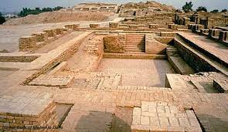
INDIAN VALLEY CIVILISATION
Indus Valley civilisation (c. 3300 BCE – c. 1750 BCE)
The Dancing Girl of Mohenjo-daro"Main article: Indus Valley civilisation
Despite its widespread and sophistication, the Indus Valley civilisation seems to have taken no interest in public large-scale art, unlike many other early civilizations. A number of gold, terracotta and stone figurines of girls in dancing poses reveal the presence of some forms of dance. Additionally, the terracotta figurines included cows, bears, monkeys, and dogs.
Much the most common form of figurative art found is small carved seals. Thousands of steatite seals have been recovered, and their physical character is fairly consistent. In size they range from ³⁄₄ inch to 1¹⁄₂ inches square. In most cases they have a pierced boss at the back to accommodate a cord for handling or for use as personal adornment. Seals have been found at Mohenjo-Daro depicting a figure standing on its head, and another, on the Pashupati Seal, sitting cross-legged in a yoga-like pose. This figure has been variously identified. Sir John Marshall identified a resemblance to the Hindu god, Shiva.

Slide 7
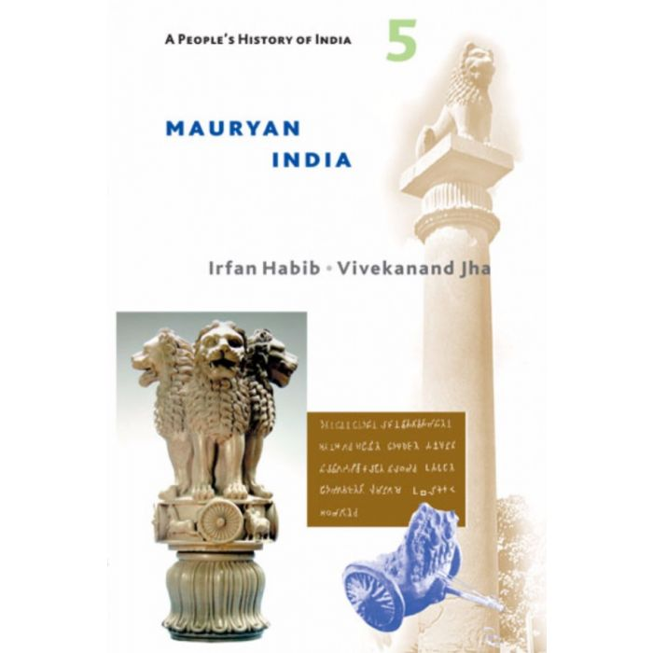
MAURYAN
Mauryan art (c. 322 BCE – c. 185 BCE)
The Pataliputra capital, an early example of Mauryan stone sculpture, displaying Persian and Hellenistic influences. 3rd century BCE, Patna MuseumThe north Indian Maurya Empire flourished from 322 BCE to 185 BCE, and at its maximum extent controlled all of the sub-continent except the extreme south as well as influences from Indian ancient traditions, and Ancient Persia, as shown by the Pataliputra capital.
The emperor Ashoka, who died in 232 BCE, adopted Buddhism about half-way through his 40-year reign, and patronized several large stupas at key sites from the life of the Buddha, although very little decoration from the Mauryan period survives, and there may not have been much in the first place. There is more from various early sites of Indian rock-cut architecture.
The most famous survivals are the large animals surmounting several of the Pillars of Ashoka, which showed a confident and boldly mature style and craft and first of its kind iron casting without rust until date, which was in use by vedic people in rural areas of the country, though we have very few remains showing its development.The famous detached Lion Capital of Ashoka, with four animals, was adopted as the official Emblem of India after Indian independence.Mauryan sculpture and architecture is characterized by a very fine Mauryan polish given to the stone, which is rarely found in later periods.
Many small popular terracotta figurines are recovered in archaeology, in a range of often vigorous if somewhat crude styles. Both animals and human figures, usually females presumed to be deities, are found.

Slide 8
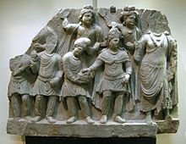
KUSHAN EMPIRE
Kushan Empire (c. 30 CE – c. 375 CE)
Officially established by Kujula Kadphises, the first Kushan emperor who united the Yuezhi tribes, the Kushan empire was a syncretic empire in central and southern Asia, including the regions of Gandhara and Mathura in northern India. From 127 to 151 CE, Gandharan reached its peak under the reign of Kanishka the Great. In this period, Kushan art inherited the Greco-Buddhist art.Mahayana Buddhism flourished, and the depictions of Buddha as a human form first appeared in art. Wearing a monk's robe and a long length of cloth draped over the left shoulder and around the body, the Buddha was depicted with 32 major lakshanas (distinguishing marks), including a golden-colored body, an ushnisha (a protuberance) on the top of his head, heavy earrings, elongated earlobes, long arms, the impression of a chakra (wheel) on the palms of his hands and the soles of his feet, and the urna (a mark between his eyebrows).
One of the hallmarks of Gandharan art is its relation to naturalism of Hellenistic art. The naturalistic features found in Gandharan sculptures include the three-dimensional treatment of the drapery, with unregularized folds that are in realistic patterns of random shape and thickness. The physical form of the Buddha and his bodhisattvas are well-defined, solid, and muscular, with swelling chests, arms, and abdomens. Buddhism and Buddhism art spread to Central Asia and the far East across Bactria and Sogdia, where the Kushan Empire met the Han Dynasty of China.

Slide 9
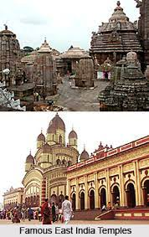
EASTERN INDIA
In east India, Odisha and West Bengal, Kalinga architecture was the broad temple style, with local variants, before the Muslim conquest.
In antiquity, Bengal was a pioneer of painting in Asia under the Pala Empire. Miniature and scroll painting flourished during the Mughal Empire. Kalighat painting or Kalighat Pat originated in the 19th century Bengal, in the vicinity of Kalighat Kali Temple of Kolkata, and from being items of souvenir taken by the visitors to the Kali temple, the paintings over a period of time developed as a distinct school of Indian painting. From the depiction of Hindu gods other mythological characters, the Kalighat paintings developed to reflect a variety of themes.
Rasmancha, Bishnupur. Built by King Bir Hambir, the temple has an unusual elongated pyramidical tower, surrounded by hut-shaped turrets, which were very typical of Bengali roof structures of the time.
Terracotta work on Shyamrai Temple, Bishnupur, depicting Raas-Leela.
Wooden Owls of Natungram, West Bengal, India. The wooden owl is an integral part of an ancient and indigenous tradition and art form in Bengal.

Slide 10
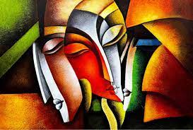
CONTEMPORARY ART
Contemporary art (c. 1900 CE-present)
In 1947, India became independent of British rule. A group of six artists – K. H. Ara, S. K. Bakre, H. A. Gade, M.F. Husain, S.H. Raza and Francis Newton Souza– founded the Bombay Progressive Artists' Group in the year 1952, to establish new ways of expressing India in the post-colonial era. Though the group was dissolved in 1956, it was profoundly influential in changing the idiom of Indian art. Almost all India's major artists in the 1950s were associated with the group. Some of those who are well-known today are Bal Chabda, Manishi Dey, V. S. Gaitonde, Krishen Khanna, Ram Kumar, Tyeb Mehta, K. G. Subramanyan, A. Ramachandran, Devender Singh, Akbar Padamsee, John Wilkins, Himmat Shah and Manjit Bawa. Present-day Indian art is varied as it had been never before. Among the best-known artists of the newer generation include Bose Krishnamachari and Bikash Bhattacharjee.

Slide 11
Painting and sculpture remained important in the later half of the twentieth century, though in the work of leading artists such as Nalini Malani, Subodh Gupta, Narayanan Ramachandran, Vivan Sundaram, Jitish Kallat, GR Iranna, Bharati Kher, Chittravanu Muzumdar, they often found radical new directions. Bharti Dayal has chosen to handle the traditional Mithila painting in most contemporary way and created her own style through the exercises of her own imagination, they appear fresh and unusual.
The increase in discourse about Indian art, in English as well as vernacular Indian languages, changed the way art was perceived in the art schools. Critical approach became rigorous; critics like Geeta Kapur, R. Siva Kumar, Shivaji K. Panikkar, Ranjit Hoskote, amongst others, contributed to re-thinking contemporary art practice in India.

Slide 12
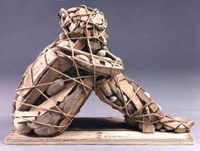
SCULPTURE
During the 2nd to 1st century BCE in far northern India, in the Greco-Buddhist art of Gandhara from what is now southern Afghanistan and northern Pakistan, sculptures became more explicit, representing episodes of the Buddha's life and teachings. Although India had a long sculptural tradition and a mastery of rich iconography, the Buddha was never represented in human form before this time, but only through some of his symbols. This may be because Gandharan Buddhist sculpture in modern Afghanistan displays Greek and Persian artistic influence. Artistically, the Gandharan school of sculpture is said to have contributed wavy hair, drapery covering both shoulders, shoes and sandals, acanthus leaf decorations, etc.

Slide 13
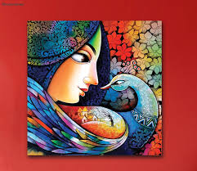
WALL PAINTING
Cave paintings in India
Fresco from the Ajanta Caves, c. 450-500The tradition and methods of Indian cliff painting gradually evolved throughout many thousands of years – there are multiple locations found with prehistoric art. The early caves included overhanging rock decorated with rock-cut art and the use of natural caves during the Mesolithic period (6000 BCE). Their use has continued in some areas into historic times. The Rock Shelters of Bhimbetka are on the edge of the Deccan Plateau where deep erosion has left huge sandstone outcrops. The many caves and grottos found there contain primitive tools and decorative rock paintings that reflect the ancient tradition of human interaction with their landscape, an interaction that continues to this day.

Slide 14
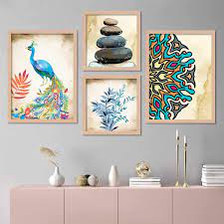
The Chola fresco paintings were discovered in 1931 within the circumambulatory passage of the Brihadisvara Temple at Thanjavur, Tamil Nadu, and are the first Chola specimens discovered. Researchers have discovered the technique used in these frescoes. A smooth batter of limestone mixture is applied over the stones, which took two to three days to set. Within that short span, such large paintings were painted with natural organic pigments. During the Nayak period the Chola paintings were painted over. The Chola frescoes lying underneath have an ardent spirit of saivism is expressed in them. They probably synchronised with the completion of the temple by Rajaraja Cholan the Great.
Kerala mural painting has well-preserved fresco or mural or wall painting in temple walls in Pundarikapuram, Ettumanoor and Aymanam and elsewhere.

Slide 15
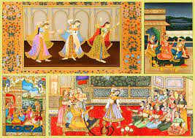
MINIATURE PAINTING
Miniature painting Akbarriding the elephant Hawa'I pursuing another elephantAlthough few Indian miniatures survive from before about 1000 CE, and some from the next few centuries, there was probably a considerable tradition. Those that survive are initially illustrations for Buddhist texts, later followed by Jain and Hindu equivalents, and the decline of Buddhist as well as the vulnerable support material of the palm-leaf manuscript probably explain the rarity of early examples.

Slide 16
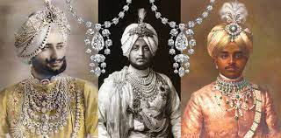
JWELLERY
Pair of gold earrings, 1st century BCE, Andhra Pradesh.The Indian subcontinent has the longest continuous legacy of jewellery-making, with a history of over 5,000 years. Using jewellery as a store of capital remains more common in India than in most modern societies, and gold appears always to have been strongly preferred for the metal. India and the surrounding areas were important sources of high-quality gemstones, and the jewellery of the ruling class is typified by using them lavishly. One of the first to start jewellery-making were the people of the Indus Valley civilization. Early remains are few, as they were not buried with their owners.

Slide 17
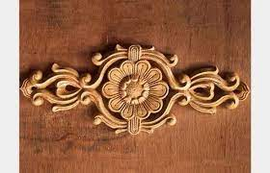
WOOD
wood was undoubtedly extremely important, but rarely survives long in the Indian climate. Organic animal materials such as ivory or bone were discouraged by the Dharmic religions, although Buddhist examples exist, such as the Begram ivories, many of Indian manufacture, but found in Afghanistan, and some relatively modern carved tusks. In Muslim settings they are more common.

Slide 18
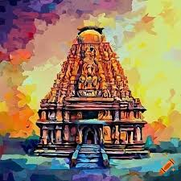
TEMPLE ART
Obscurity shrouds the period between the decline of the Harappans and the definite historic period starting with the Mauryas, and in the historical period, the earliest Indian religion to inspire major artistic monuments was Buddhism. Though there may have been earlier structures in wood that have been transformed into stone structures, there are no physical evidences for these except textual references. Soon after the Buddhists initiated rock-cut caves Hindus and Jains started to imitate them at Badami, Aihole, Ellora, Salsette, Elephanta, Aurangabad and Mamallapuram and Mughals. It appears to be a constant in Indian art that the different religions shared a very similar artistic style at any particular period and place, though naturally adapting the iconography to match the religion commissioning them.Probably the same groups of artists worked for the different religions regardless of their own affiliations.

Slide 19
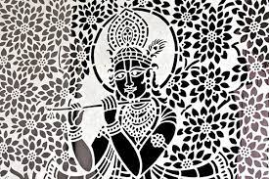
FOLK AND TRIBAL ART
Warli painting from MaharastraFolk and tribal art in India takes on different manifestations through varied media such as pottery, painting, metalwork,paper-art, weaving and designing of objects such as jewellery and toys. These are not just aesthetic objects but in fact have an important significance in people's lives and are tied to their beliefs and rituals. The objects can range from sculpture, masks (used in rituals and ceremonies), paintings, textiles, baskets, kitchen objects, arms and weapons, and the human body itself (tattoos and piercings). There is a deep symbolic meaning that is attached to not only the objects themselves but also the materials and techniques used to produce them.

Slide 20
THREE MAJOR PERIODS IN THE HISTORY OF INDIAN MUSIC
The history of Indian music can be studied under three major periods like Ancient, Medieval and Modern. The era of Ancient music extends from the Vedic Age after which the medieval system of music evolved. Around 14th century it culminated in the bifurcation of the Indian music into two branches- Hindustani and Carnatic systems. Both these branches evolved and established themselves firmly. During this period, innumerable musicologists and composers appeared on the scene and enriched the concepts of Raga, Tala and musical forms.
There are two type of music in India
Hindustani music (based on swara)
carnatic music (based on sruti)
Hindustani music was transcribed by Pandit Vishnu Narayan Bhatkhande ji.
Carnatic music ws transcribed by vishnu digambar paluskar

Slide 21
Indian Classical Dance, Or Shastriya Nritya
Indian classical dance, or Shastriya Nritya, is an umbrella term for different regionally-specific Indian classical dance traditions, rooted in predominantly Hindu musical theatre performance,] the theory and practice of which can be traced to the Sanskrit text Natya Shastra.The number of Indian classical dance styles ranges from six to eight to twelve, or more, depending on the source and scholar] the main organisation for Indian arts preservation, the Sangeet Natak Academy recognizes eight: Bharatanatyam, Kathak, Kuchipudi, Odissi, Kathakali, Sattriya, Manipuri and Mohiniyattam. Additionally, the Indian Ministry of Culture includes Chhau in its list, recognising nine total styles. Scholars such as Drid Williams add Chhau, Yakshagana and Bhagavata Mela to the list. Each dance tradition originates and comes from a different state and/or region of India; for example, Bharatanatyam is from Tamil Nadu in the south of India, Odissi is from the east coast state of Odisha, and Manipuri is from the northeastern state of Manipur. The music associated with these different dance performances consists many compositions in Hindi, Malayalam, Meitei (Manipuri), Sanskrit, Tamil, Odia, Telugu, and many other Indian-Subcontinent languages; they represent a unity of core ideas, and a diversity of styles, costumes and expression.

Slide 22
INDIAN CLASSICAL DANCE
Indian classical dances are traditionally performed as an expressive drama-dance form of religious performance art, related to Vaishnavism, Shaivism, Shaktism, pan-Hindu Epics and the Vedic literature, or a folksy entertainment that includes story-telling from Sanskrit or regional language plays. As a religious art, they are either performed inside the sanctum of a Hindu temple, or near it. Folksy entertainment may also be performed in temple grounds or any fairground, typically in a rural setting by travelling troupes of artists; alternatively, they have been performed inside the halls of royal courts or public squares during festivals.

Slide 23
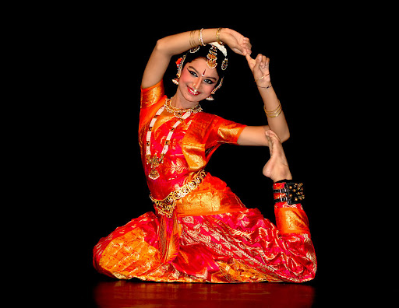
However, this is not the case for Kathak, Manipuri and Chhau as it has their own uniqueness. Kathak can be also performed on courtyards of mosques and had Muslim elements while Manipuri had the huyen langlon genre which focuses on combat. Like Manipuri, Chhau also had elements on combat.

Slide 24
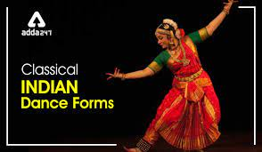
DANCE FORMS
The Natya Shastra mentions four Pravrittis (traditions, genres) of ancient dance-drama in vogue when it was composed – Avanti (Ujjain, central), Dakshinatya (south), Panchali (north, west) and Odra-Magadhi (east).
Sources differ in their list of Indian classical dance forms. Encyclopædia Britannica mentions six dances. The Sangeet Natak Akademi has given recognition to eight Indian dances. The Indian government's Ministry of Culture includes nine dance forms. Scholars such as Drid Williams and others include Yakshagana and Bhagavata Mela to the nine classical Indian dances in the Sangeet Natak Akademi list.
The classical dance forms recognised by the Sangeet Natak Akademi and the Ministry of Culture are:

Slide 25
Eight classical dances recognised by the Sangeet Natak Akademi and the Ministry of Culture
Bharatanatyam, from Tamil Nadu
Kathak, from northern India
Kathakali, from Kerala
Kuchipudi, from Andhra Pradesh
Manipuri, from Manipur
Mohiniyattam, from Kerala
Odissi, from Odisha
Sattriya, from Assam
Other dances also recognised by the Ministry of Culture
Chhau, from Eastern India (Odisha, Jharkhand and West Bengal)

Slide 26
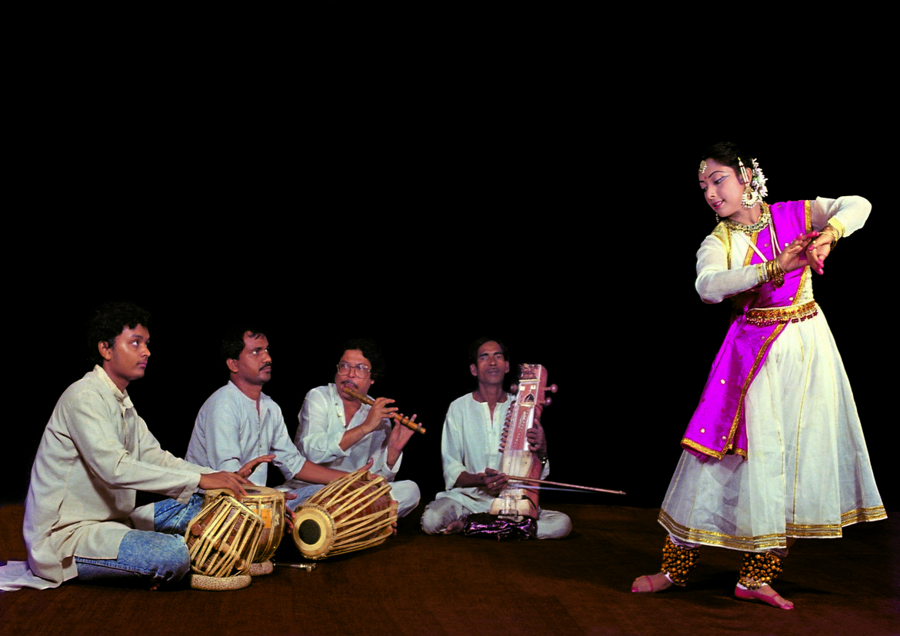
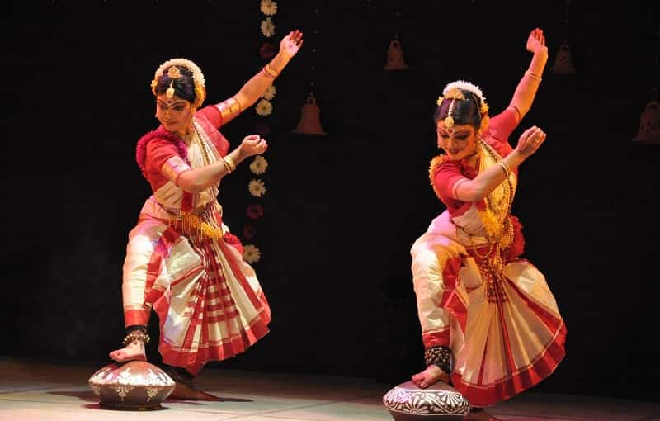
FAMOUS INDIAN DANCERS
Some famous Indian classical dancers are :
Kathak - Birju Maharaj, Nahid Siddiqui, Lacchu Maharaj, Gopi Krishna, Saswati Sen, Manjari Chaturvedi
Gaudiya Nritya - Mahua Mukherjee

Slide 27
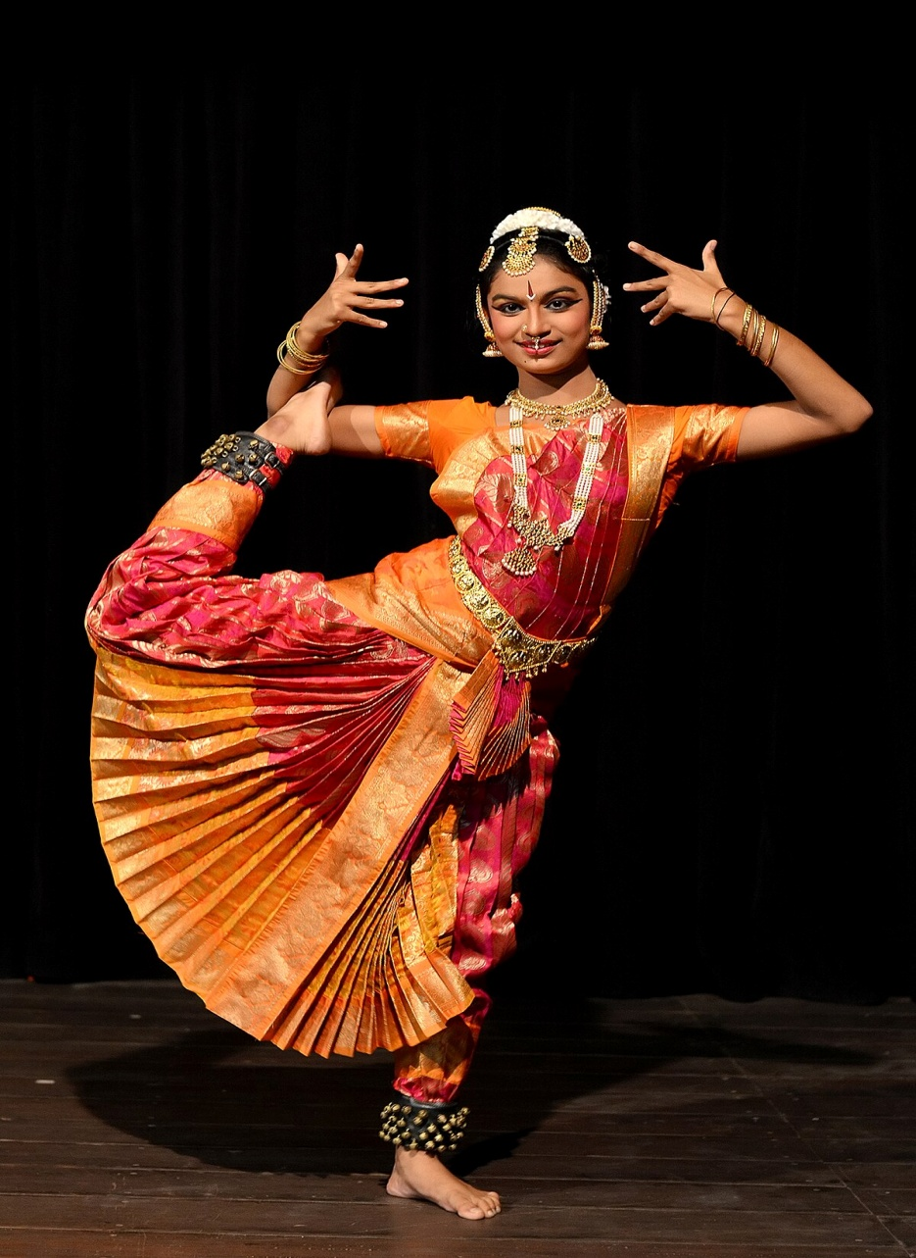
Bharatanatyam - Rukmini Devi Padma Subrahmanyam, Vyjayanthimala, Sheema Kermani, Padmini

Slide 28
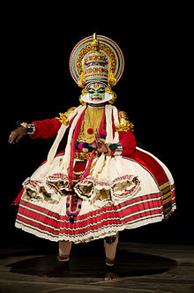
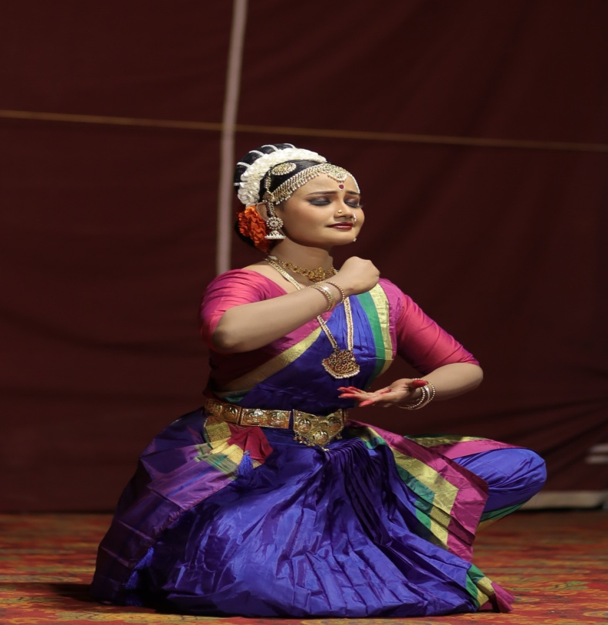
Kathakali - Kalamandalam Krishnan Nair
Kuchipudi - Mallika Sarabhai, V. Satyanarayana Sarma, Deepa Shashindran

Slide 29
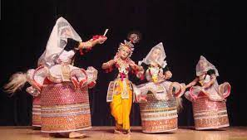
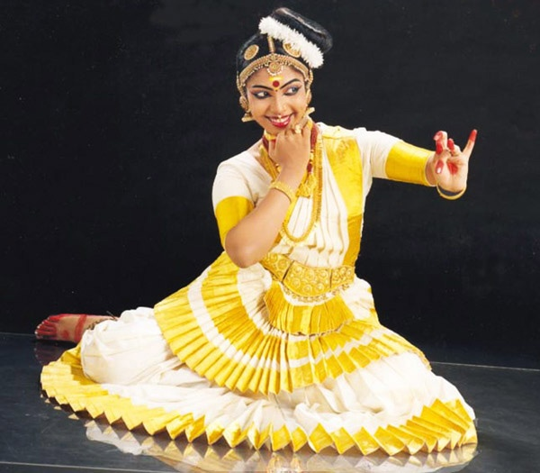
Manipuri - Guru Bipin Singh, Darshana Jhaveri, Jhaveri Sisters, Devjan Chaliha, Amala Shankar
Mohiniyattam - Kalamandalam Kalyanikutty Amma, Shobhana, Sunanda Nair, Kalamandalam Radhika, Thankamani, Kalamandalam Hymavathy

Slide 30
Indian Musical Instruments
India has the most ancient and evolved music system in the world. The earliest evidence points to this discovery in the cave paintings showing musical activity and instruments at Bhimbetka in Madhya Pradesh (Central India), dating back 10,000 years ago. Similarly, during the later excavations of the Harappan civilization, evidence of musical activity and dance was uncovered. The study of such evidence helps us understand the evolution of music and several cultural aspects of the people who used these instruments.
The Natya Shastra, an ancient encyclopedia of the arts, compiled by Bharat Muni (200 B.C.- 200 A.D.), categorized musical instruments (vadya) into four main categories:
Tantu Vadya - Chordophones or Stringed instruments
Sushira Vadya - Aerophones or Wind instruments
Avanaddha Vadya - Membranophones or Percussion instruments
Ghana Vadya - Idiophones or Solid instruments that do not require tuning.
There have been many instruments of the distant past, of which we only know names. There are numerous instruments used in folk music too. The focus of this article is to describe instruments used in Indian Classical music.

Slide 31
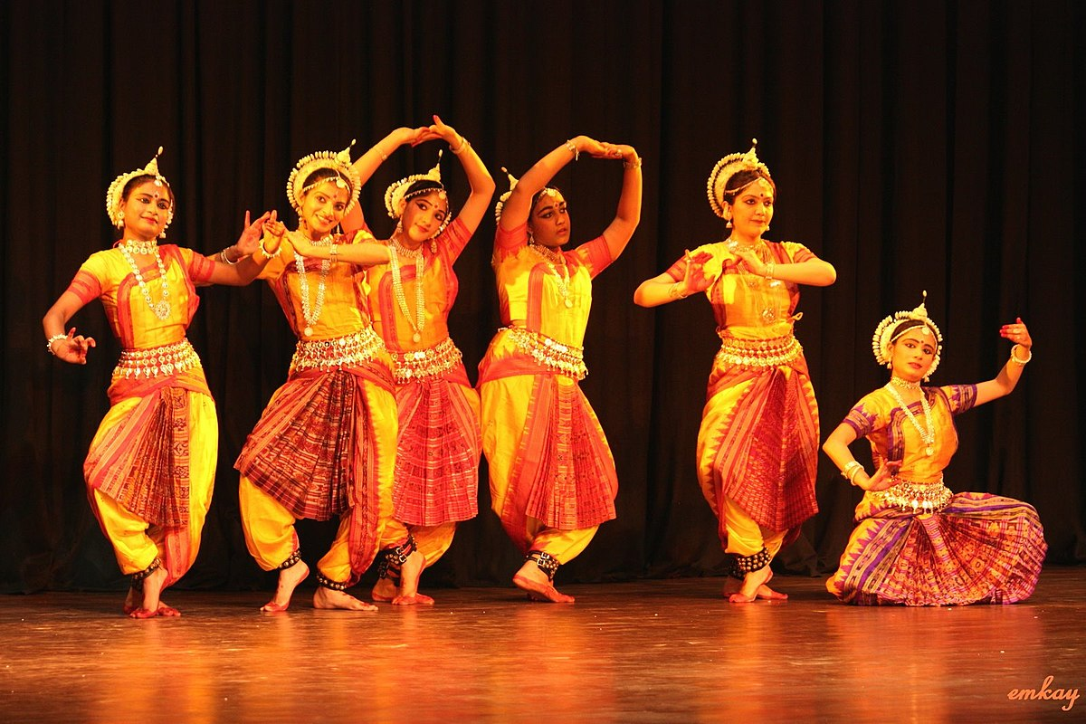
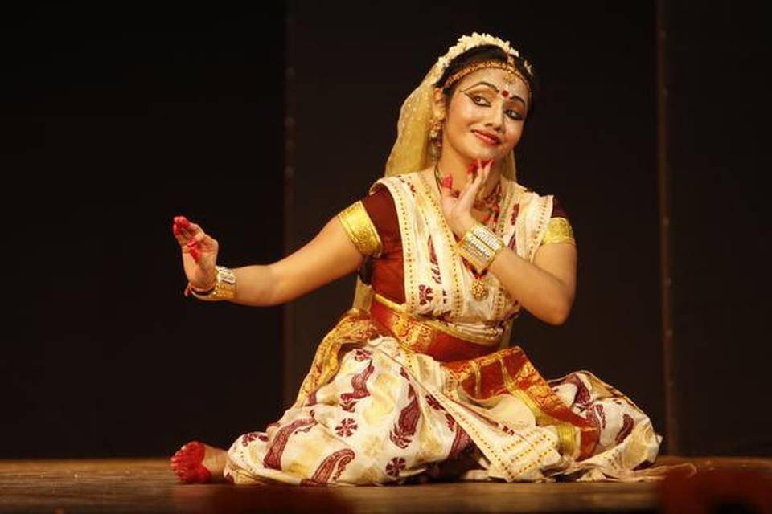
Odissi - Sujata Mohapatra, Madhavi Mudgal, Keluchara Mohapatra, Surendra Nath Jena, Shobana Sahajananan, Minati Mishra
Sattriya - Indira P. P. Bora, Ghanakanta Bora, Sarodi Saikia

Slide 32
MYTHOLOGICAL ORIGIN OF SANGEET
Mythological origins By looking at mythology one can really see the significance that Indian music (sangeet) has to Indian society. This is illustrated in the story concerning its origin. In the N¯at.ya S¯astra ´ , which is the oldest surviving text on stagecraft in the world (circa 2nd century B.C.), the author Bharata writes: Once, a long time ago, during the transitional period between two Ages it so happened that people took to uncivilised ways, were ruled by lust and greed, behaved in angry and jealous ways with each other and not only gods but demons, evil spirits, yakshas and and such like others swarmed over the earth. Seeing this plight, Indra and other gods approached god Brahma and requested him to give the people a toy (Kridaniyaka), but one which could not only be seen but heard and this should turn out a diversion (so that people gave up their bad ways)

Slide 33
HISTORICAL DEVELOPMENT
Although it was decided to give the celestial art of sangeet to mankind, a suitable human had to be found who was capable of receiving this gift. Sangeet had always been in the realm of the demigods (g¯andharva). A super–human of superior spiritual ability was required to convey this celestial artform to the world of man. It fell upon the great sage Narada to be the first mortal recipient of this divine art. Through Narada, we are indebted for the presence of classical music. 1.2 Historical development There are many important events in the history of Indian music. These milestones show the development of musical thought from early history to the present day.

Slide 34
The classical music of India is said to have its roots in this culture. The connection between Indo–European expansion and Indian music may be seen in mythology. Mythology refers to music being brought to the people of India from a place of celestial beings. This mythical land (G¯andharva Desh) is usually equated with heaven. However, some are of the opinion that this mythical land could actually be Kandahar in what is the modern Afghanistan. Therefore, the myths of music being given to the world by the celestial beings (g¯andharva) may actually represent a cultural connection with this ancient Indo–Aryan homeland.

Slide 35
PITCH AND BEAT IN INDIAN MUSIC: RAGAS & TALAS
Indian classical music is based on the concept of ragas, which are melodies that evoke certain emotions in the listener. Some of the most popular ragas used in Indian music include Bhairav, Yaman, Malkauns, Todi, Bhupali, Marwa, and Darbari. Each raga has a distinct melodic structure and is associated with a particular time of day, season, or mood.
Talas are rhythmic cycles used in Indian classical music. They are composed of a specific number of beats and can be used to structure improvisations, compositions and performances. Talas are divided into three parts: thekhādī, the vibhāg and the laggī. Thekhadi is the cyclical pattern of beats, the vibhag divides the cycle into two halves and the laggi is the part of the cycle which is improvised. Each tala has its own unique character, which is determined by the number of beats and the way in which they are grouped together. Talas are an essential part of Indian classical music, and are used to create a sense of structure, repetition and form in the music.
Like the maqam system in Arab music, in Indian classical music, a raga is a melodic mode or framework that serves as the foundation for a composition or improvisation. It is characterized by a specific set of melodic rules and guidelines, including the use of certain notes, the order of the notes, and the way they are ornamented.
Each raga has a specific mood or emotion associated with it and is meant to be performed during certain times of the day or in specific seasons.

Slide 36
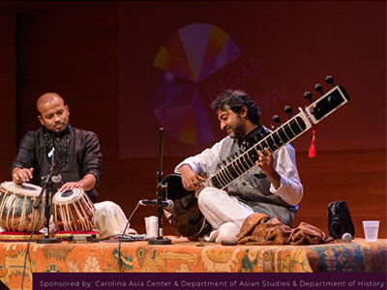
RAAG
Ragas are classified into various types such as Janaka, Janya, and Upanga.
Janaka ragas are the “parent” ragas from which many other ragas are derived.
Janya ragas are derived from Janaka ragas and are its “children”
Upanga ragas are Janya ragas that have been modified or adapted in some way.
In Hindustani music there are ten thaats and in Carnatic music seventy-two Melakartha ragas.
Ragas are also accompanied by tala, which is the rhythmic pattern that serves as the foundation for the composition or improvisation. Each tala is characterized by a specific number of beats and a specific time-cycle.

Slide 37
In Indian classical music, a tala is a rhythmic cycle that serves as the foundation for a composition or improvisation. It is characterized by a specific number of beats and a specific time-cycle and is usually indicated by a specific hand or finger gesture called a “kriya” that is used by the percussionist to signal the start of each cycle.
Tala is an integral part of Indian classical music and is used in both Hindustani and Carnatic music traditions. The use of tala creates a structure for the improvisation and composition by providing a framework for the musicians to build their improvisations around.
In Hindustani music, talas are classified into four main categories: Trital, Dhamar, Ek tal, and Jhaptal.
In Carnatic music, talas are classified into three main categories: Tisra, Chatusra, and Misra.
Each tala has its own specific name, such as Dadra, Jhaptal, and Rupak in Hindustani music and Adi, Rupaka, and Triputa in Carnatic music.
The use of talas requires a high level of skill and practice to master, as the musician must be able to keep a steady beat while also improvising and adapting to the other musicians in the ensemble.

Slide 38
A quarter tone, also known as a microtone, is a musical interval that is equal to one-fourth of a semitone. In Indian music, quarter tones are used to express subtle inflections in melody and are an integral part of the melodic system. These subtle melodic nuances are often used to create a sense of tension and release and to create a feeling of improvisation. Quarter tones are also used to create a more complex texture in ragas, or melodic forms, by adding additional notes to a particular phrase. Quarter tones and microtones are used extensively in Northern Indian classical music, where a raga is composed with precise intonation and intricate ornamentation.

Slide 39
Microtones are tones that fall between the standard twelve-note chromatic scale. In Indian music, microtones are used to create a more subtle and nuanced sound. They are important in making ragas (melodies) and talas (rhythmic cycles) more expressive.
Microtones can be used to make a note sound higher or lower than it would on the standard twelve-note chromatic scale, which can result in a more complex and emotive sound. Indian music also makes use of vibrato, which is a slight fluctuation in pitch. This creates a more complex sound and can be used to add expression and emphasis to a performance.

Slide 40
TIMBRE AND INSTRUMENTS IN INDIAN MUSIC
Indian classical music is traditionally performed on a variety of instruments, many of which have been in use for centuries. Some of the most used instruments in Indian classical music include:
Sitar: A long-necked string instrument with a large number of strings that is played with a plectrum (mizrab) and is commonly used in Hindustani music.
Sarod: A string instrument with a deep, mellow tone that is played with a plectrum (jawari) and is commonly used in Hindustani music.
Tabla: A pair of small hand drums that are played with the fingers and palms and are used to provide the rhythm in Indian classical music.
Harmonium: A small reed organ that is played with the fingers and is used to provide accompaniment in Indian classical music.
Mridangam: A double-headed drum that is played with the hands and is commonly used in Carnatic music.

Slide 41
Kanjira: A tambourine-like instrument that is played with the hands and is commonly used in Carnatic music.
Violin: A bowed string instrument that is played with a bow and is commonly used in both Hindustani and Carnatic music.
Flute: A wind instrument that is played by blowing into a hole and is commonly used in both Hindustani and Carnatic music.
Sarangi: A bowed string instrument that is played with a bow and is commonly used in Hindustani music.

Slide 42
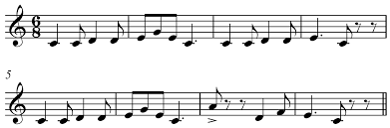
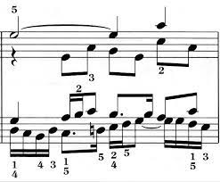
TEXTURE IN INDIAN MUSICs
In Indian music, texture refers to the way in which the different musical elements of a piece are arranged and combined. There are several different types of texture found in Indian music, including:
Monophonic: A monophonic texture is one in which a single melody is played or sung. This is often the case in traditional Indian vocal music, where a solo vocalist sings a melody accompanied by a drone or a simple percussion instrument.
Polyphonic: A polyphonic texture is one in which multiple melodies are played or sung simultaneously. This is less common in Indian music, but can be found in some forms of Indian classical music, such as the South Indian carnatic music where there is a use of counterpoint melodies.

Slide 43
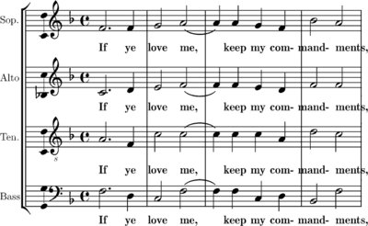
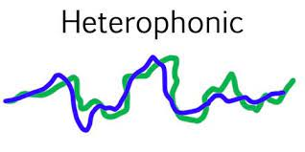
Homophonic: A homophonic texture is one in which multiple voices or instruments play or sing the same melody simultaneously, but with slightly different variations. This type of texture is common in Indian classical music, particularly in ensemble performances where multiple instruments play the same melody in a coordinated manner.
Heterophonic: A heterophonic texture is one in which multiple voices or instruments play or sing the same melody simultaneously, but with slightly different variations. This is a common feature in Indian classical music, particularly in improvisation, where the musicians play the same melody with different nuances.

Slide 44
Tantu Vadya
This is the category of string instruments. In this category, the sound is produced by the string's vibration through plucking or bowing on the string. The pitch and the sound vibration depend on the string's length and how tight it is wound to the instrument.
The Tantu Vadya are divided broadly into three categories:
Tat Vadya - The plucked instruments such as Tanpura, Veena, Sitar, Sarod, of which Veena and Sitar are fretted, whereas Sarod is non-fretted.
Vitat Vadya - The bowed instruments such as Violin, Sarangi, Dilruba and Esraj or Israj.The only string instrument that is neither plucked nor bowed is the Santoor, which is played by hammering on the strings.
Scroll through the following images of stringed instruments to learn more.
Veena - Veena, a plucked string instrument is one of the most ancient Indian musical instruments.
Violin - The violin originated in the 16th century in Italy. The western Violin was adapted to Indian classical music in the last century.
Sarangi
The Sarangi is a highly expressive instrument. Its name means 'a hundred colors,' referring to the range, depth, and subtlety of its sounds.
Santoor
The Indian Santoor instrument is a trapezoid-shaped hammered dulcimer.

Slide 45
Swar Mandal
Swarmandal is a harp-like drone instrument used by a Hindustani classical vocalist for accompaniment.
Tanpura
Tanpura is a drone instrument that has four strings. It produces a vibrant sound and is used for accompaniment by both vocalists and instrumentalists.
Sarod
The word Sarod comes from the Persian word “Sarood”, which means "melody." It is believed that the Sarod originated by combining the ancient Chitravina with the medieval Indian rabab and the Sursingar.
Sitar
Sitar has a rich cultural heritage; it originated from the ancient Veena. Its origins can also be traced to the Persian word "Sehtar."

Slide 46
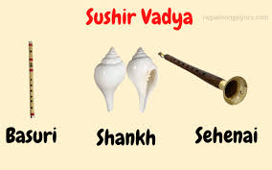
SUSHIR VADYA
Sushir Vadya or aerophones are wind instruments. These instruments use air as the primary vibrating medium for producing sound. They are diverse in structure and have been used in the music of all cultures since prehistoric times. A wind instrument has a tube, which is the resonator, in which a column of air is set into vibration. The player blows into the mouthpiece, which is set at or near the end of the resonator. In some instruments, the air can be pumped mechanically.

Slide 47
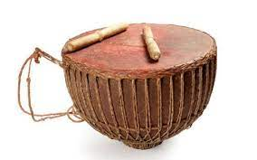
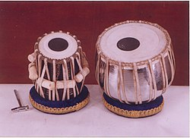
Avanaddha Vadya
These are membrophones or percussion instruments.
Tabla
Tabla is the most popular percussion instrument used as an accompaniment in Indian music.

Slide 48
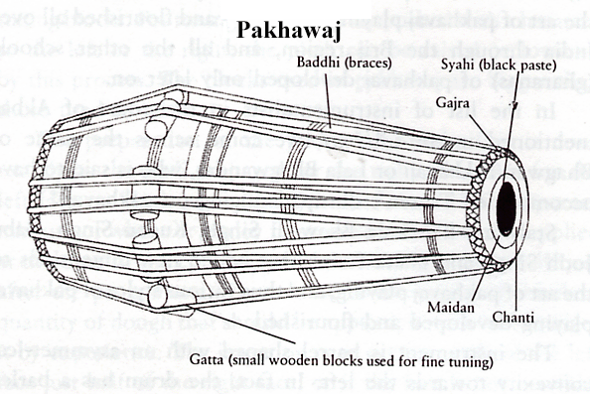
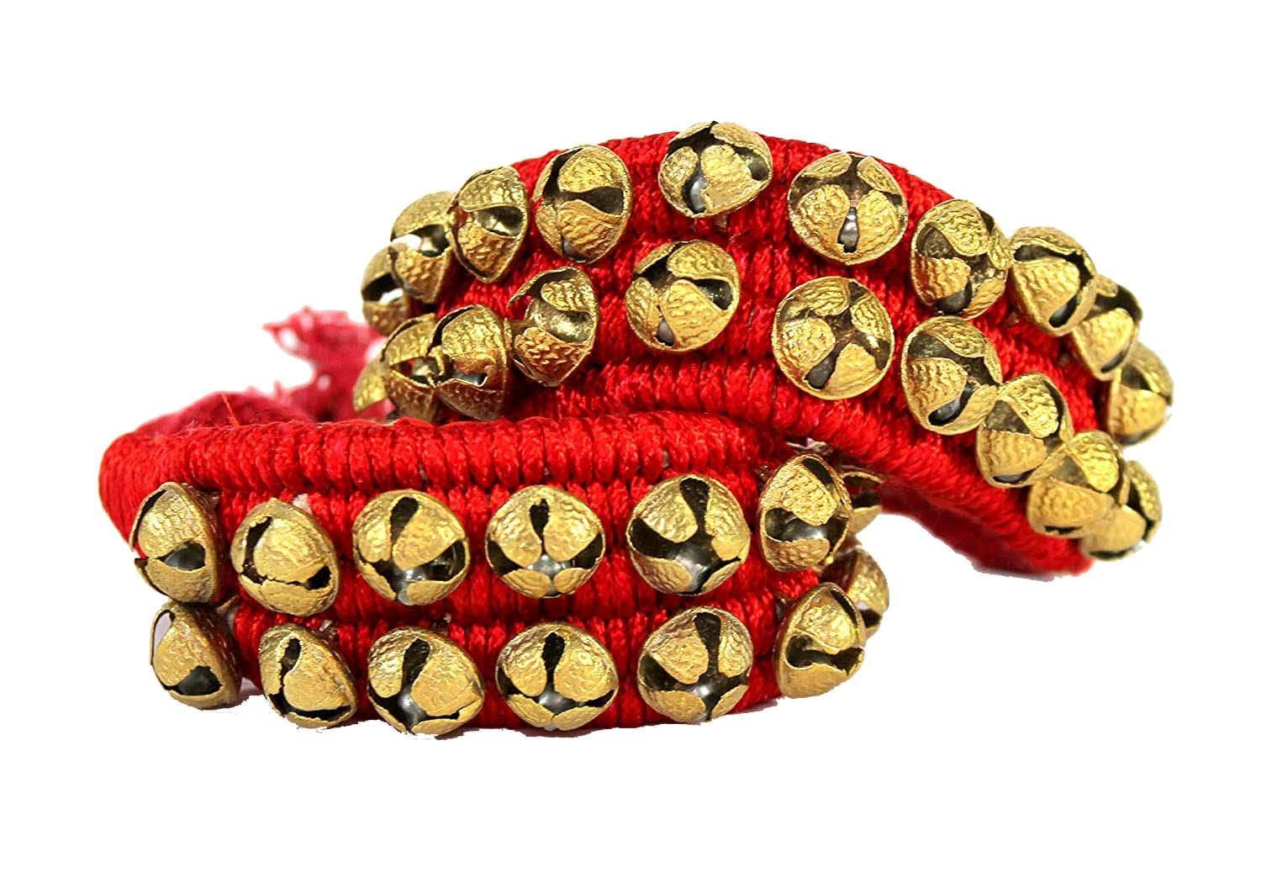
Pakhawaj
Considered a descendant of Mridangam, the Pakhawaj is mainly used to accompany the Dhrupad style of Hindustani classical music.
Ghungroo
Several metallic bells are strung together on a thick cloth to make Ghungroo.

Slide 49
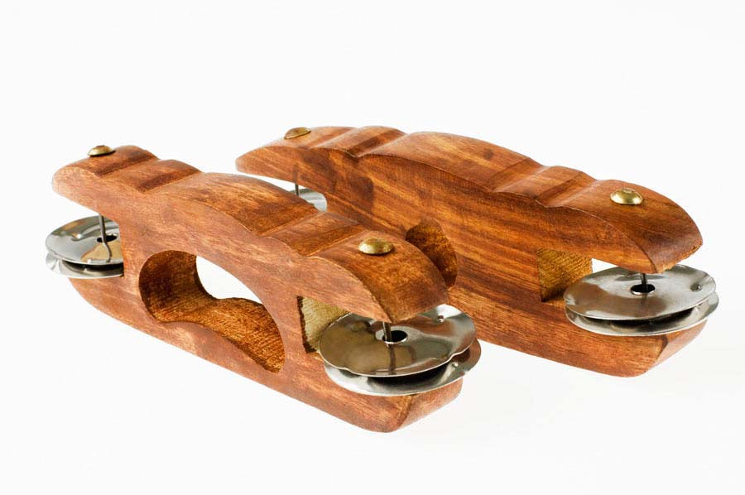
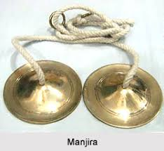
Ghana Vadya
These are idiophones which make a sound when struck or shaken. They are solid instruments that do not require
Manjira
Derived from the Sanskrit word, Tālà, which means rhythm, the Taal/ Kartaal or Manjira is a pair of clash cymbals made of bronze, brass, copper, or zinc

Slide 50
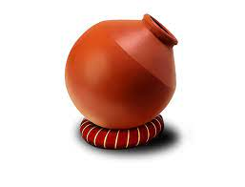
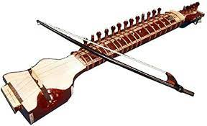
Ghatam: A clay pot that is played with the hands and is commonly used in Carnatic music.
Dilruba
Dilruba is a bowed string instrument that is very close to the combination of Sitar and Sarangi.

Slide 51
History of Indian Music & Musical Instruments
Nature is the fountain source of all music. The beginning of Indian musicography is traced to Vedic chants that were sung during religious rituals performed by priests named Udgatar. The origin of musical composition is traced to the Vedic chant of Samveda (the Veda of music) created by Lord Brahma. In Vedic times music was the medium for prayer in religious ceremonies as well as entertainment and social occasions. The development of notes originated in the Vedic period itself.
There was a lot of influence of Mughals on Indian music over a period of time. They contributed a lot for Indian music.
India has a rich musical history with its very own musical instruments. Some music instruments are used primarily in North Indian music (Hindustani Sangeet), some are used in the south Indian music (Carnatic Sangeet), while others are found in folk music. The music of ancient India has its roots from the many indigenous instruments that gained wide use at the time such as the seven-holed flute and various stringed instruments. The oldest musical instrument of India is the Veena.

Slide 52
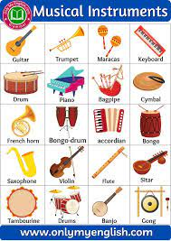
DIFFERENT MUSICAL INSTRUMENTS
In the Natya Shastra musical instruments have been divided into four main categories on the basis of how sound is produced.
The Tata Vadya or Chordophones- Stringed instruments – The instruments in which sound is produced by the vibrations in stretched metal wires are called string instruments e.g. sitar, violin, sarangi, sarod, tanupura/tambura etc.
The Sushira Vadya or Aerophones- Wind instruments (Flute instruments & Reed instruments) – The instruments in which sound is produced by the vibrations in air column are called wind instruments e.g. flute, shehnai etc.
The Avanaddha Vadya or Membranophones- Percussion instruments– The instruments in which sound is produced by the vibrations of a stretched skin are called percussion instruments e.g. tabla, dholak, mrindangam, drums etc.
The Ghana Vadya or Idiophones- Solid instruments which do not require tuning and the earliest instruments invented by man e.g. Manjira, Khartal, Chimta, Morchang, Jaltarang, Ghatam.
We have shortlisted to describe only a few popular musical instruments which are integral parts of Indian Music..

Slide 53
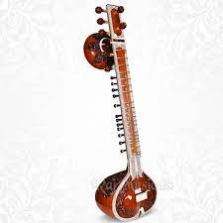
VINA
Saraswati Veena – Stringed Instrument
The Saraswati Veena, one of the most ancient Indian instruments, is a plucked stringed instrument used mainly in the south Indian – Carnatic classical musical. It is called “The Queen of Instruments” in the classical music of South India. The Saraswati Veena, whose origins date back to around 1700 BCE, occupies a place of pride among Indian musical instruments.
There are 4 types of Veena Instruments considered by scholars now-a-days and they are the Tanjavur (Saraswati) Veena, Rudra Veena, Vichitra Veena, and Gottuvadhyam (Chitra) Veena. Basically, it is mostly used in Carnatic Music, a form of South Indian Classical Music. The current form of the Saraswati Veena with 24 fixed frets evolved in Thanjavur, Tamil Nadu, during the reign of Raghunatha Nayak and it is for this reason sometimes called the Tanjore Veena or the Raghunatha Veena. The Saraswati Veena contains 4 lead strings to play the solo lead part of the music and 3 drone strings.

Slide 54
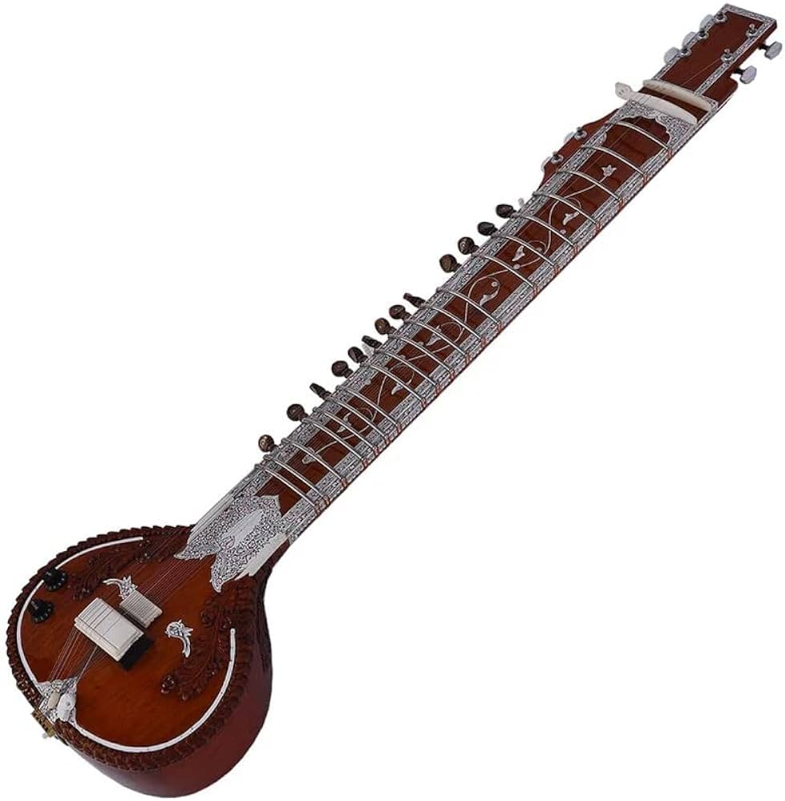
Sitar- Stringed Instrument
The Sitar, one of the most ancient Indian instruments, is a plucked stringed instrument used mainly in Hindustani music – North Indian classical music. It is said to have been introduced in India in the thirteenth century by Amir Khusrau, the first great Muslim musicologist of India. The instrument’s name is derived from the Persian ‘setar’, or three-stringed. The influence of sitar can be largely seen towards the north side of India due to the Mughal dynasty impact. The captivating music from the strings of sitar has attracted many well known musical artists around the globe, musical bands like the Beatles and the Rolling Stones use sitar for their performance. The Sitar occupies a place of pride among Indian musical instruments. It is easily the most charming of all instruments.

Slide 55
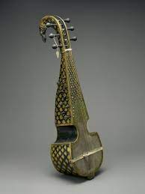
SAROD – STRINGED INSTRUMENT
Sarod is a combination of the ancient Indian instruments veena and medieval rebab. Originating from the Rebab, a musical instrument of the Middle East, use of Sarod in Indian classical music can be traced back to the greatest musician ‘Tansen’. It is also said that Saheb Asadullah Khan began the use of Sarod as a musical instrument in Bengal in earlier days. Thereafter, Bengal became famous for manufacturing this musical instrument. Sarod is made of teak wood. This miniature musical instrument narrates the fascinating story of India’s musical heritage.

Slide 56
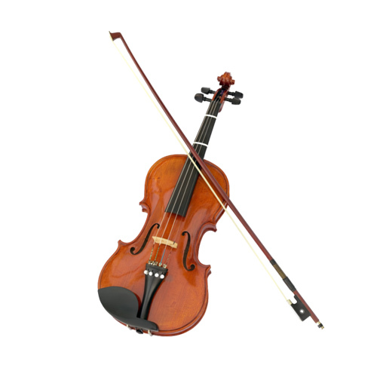
VIOLIN- STRINGED INSTRUMENT
Violin is a four stringed instrument played with a bow. Violin plays a prominent role in carnatic music. Violin has been introduced to Carnatic music during the end of 18th century and start of 19th century. Violin became popular with the Carnatic parlance not only as the accompaniment, but also as a solo instrument. The ancestor of the Violin is believed to be the Ravanahatha, a folk instrument of Rajasthan, in India. Ravanahatha, is said to have originated during the time of Ravana, the mighty king of Lanka. According to mythology, Ravana was an ardent devotee of Lord Siva. He played on the Ravanhatta as a musical offering to the Lord. The violin has often been described as a musical bridge between Europe and India, as it is the only European instrument that has been successfully integrated into Indian classical music. Although the construction of the violin is the same in Indian and Western music, the tuning, playing posture, and techniques are quite different.

Slide 57
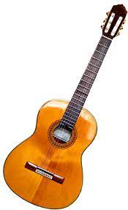
GUITAR- STRINGED INSTRUMENT
Most of the music exponents attribute the guitar as a western instrument but quite a few know that guitar was played in the ancient days in India during the Vedic period; the form of music was Samgan. The kachhapi veena was used in this period for solo performances and also as an accompanying instrument. This instrument later on is believed to have migrated to different parts of the world and acquired different names while it vanished from India. The classical gut-string guitar appeared in the musical circles in Madras around the 1840s. The steel string guitar has gained popularity in the North-East region of India and Goa and become mainstream Indian instruments in popular settings and have also occasionally been incorporated in Indian classical music, ghazals and other so-called “light music” forms in India. Acoustic guitars have 6 strings and are great for beginners as they are simple and easy to use.
Photo: Pandit Vishwa Mohan Bhatt – a Mohan Veena player. Mohan Veena – a modified version of slide guitar (a technique for playing the guitar that is often used in blues music.) player; Credit: The Hindu.

Slide 58
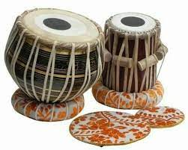
DUGI TABLA – PERCUSSION INSTRUMENT
Dugi Tabla is an important rhythmic accompaniment to vocal, instrument and dance performances. Dugi Tabla – a percussion instrument which consists of a pair of single headed drums – Dugi/Bayan or the larger drum and Tabla/Dayan or the smaller drum. As an instrument of Indian heritage, Dugi Tabla has great importance in accompanying vocals and other types of instruments. There are many theories regarding the invention of the Tabla. The first assumption was that it was discovered by a drummer named Amir Khusru in the first half of the 18th century. The second assumption is connected with the Indian mythology which told that Lord Ganesh once while playing the parental Indian instrument pakhavaj, accidentally dropped it and that’s how the partition gave us Tabla. Tabla also has a great deal of importance in the accompaniment of dance. There are various Indian traditional dance forms such as Bharatanatyam, Kathak, Odissi, and many other south Indian dances. In all these dance forms, especially in North Indian dance Kathak, the tabla is popularly used for accompaniment. In vocals too, the tabla is used in showing the tala to the singer.

Slide 59
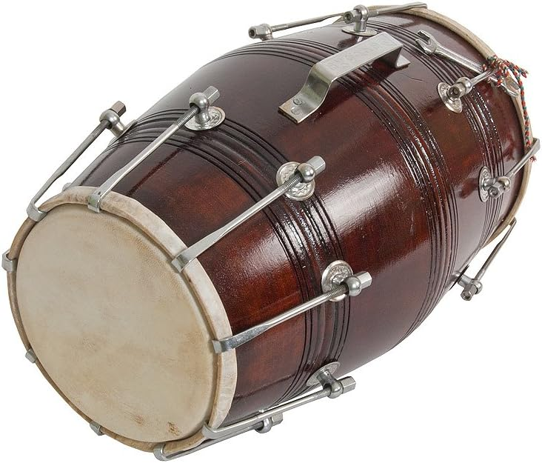
DHOLAK- PERCUSSION INSTRUMENT
Dholak – A two-headed hand drum, Dholak is a folk percussion instrument. The dholak is the most commonly played musical instrument in Northern India. Dholak can be played in three ways- on the player’s lap, while standing, or pressed down with one knee while sitting on the floor. It appears to be in barrel shape with simple skin covering on the right and left hand sides. The instrument is widely used at the Lavani – a traditional song and dance form of Maharashtra, Punjabi folkloric dance music called bhangra and other dance forms in India. The high pitch rhythm that is produced makes people experience an enthusiastic level and everybody would want to perform to the rhythm. In northern parts of India it becomes a must use instrument at occasions such as sangeet, traditional events and other singing competition

Slide 60
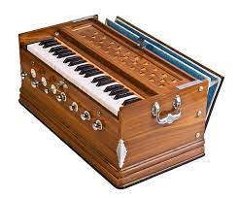
HARMONIUM
Harmonium – Wind Instrument – Reed Instrument
Harmonium, a keyboard musical instrument, is often used as an accompanying instrument by vocalists. During the mid-19th century missionaries brought French-made hand-pumped harmoniums to India. Though derived from the designs developed in France, the harmonium was developed further in India in unique ways, such as the addition of drone stops and a scale changing mechanism. It is extensively used to accompany folk, classical, Sufi, and ghazal compositions for both music and dance. The harmonium is also commonly accompanied by the Tabla.
Listen to Vidushi Kishori Amonkar sings playing harmonium

Slide 61
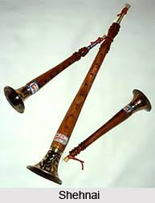
SHEHNAI
Shehnai – Wind Instrument – Reed Instrument
The Shehnai is a reed instrument in which there are seven holes along the tube which are used for playing the melody by opening and closing them with the fingers. In the past, the Shehnai was part of the naubat (traditional ensemble of nine instruments found at royal courts). It is known as a Mangal vadya and is usually played on all auspicious occasions in north India such as marriages, temple festivals, etc.

Slide 62
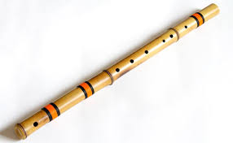
BANSURI (FLUTE)
Bansuri – Wind Instrument– Flute Instrument
Single or double flutes with only one hollow tube with finger holes for controlling the pitch of the note are very common in many parts of the country. The flute has a variety of names like Venu, Vamsi, Bansuri, Murali and so on in the north, and Pullankuzhal, Pillankarovi and Kolalu in the south. The bansuri ( bans [bamboo] + swar [a musical note] ) is a transverse alto flute made of a single length of bamboo and has six or seven open finger holes. The bansuri is revered as Lord Krishna’s divine instrument and is often associated with Krishna’s Rasa lila dance.

Slide 63
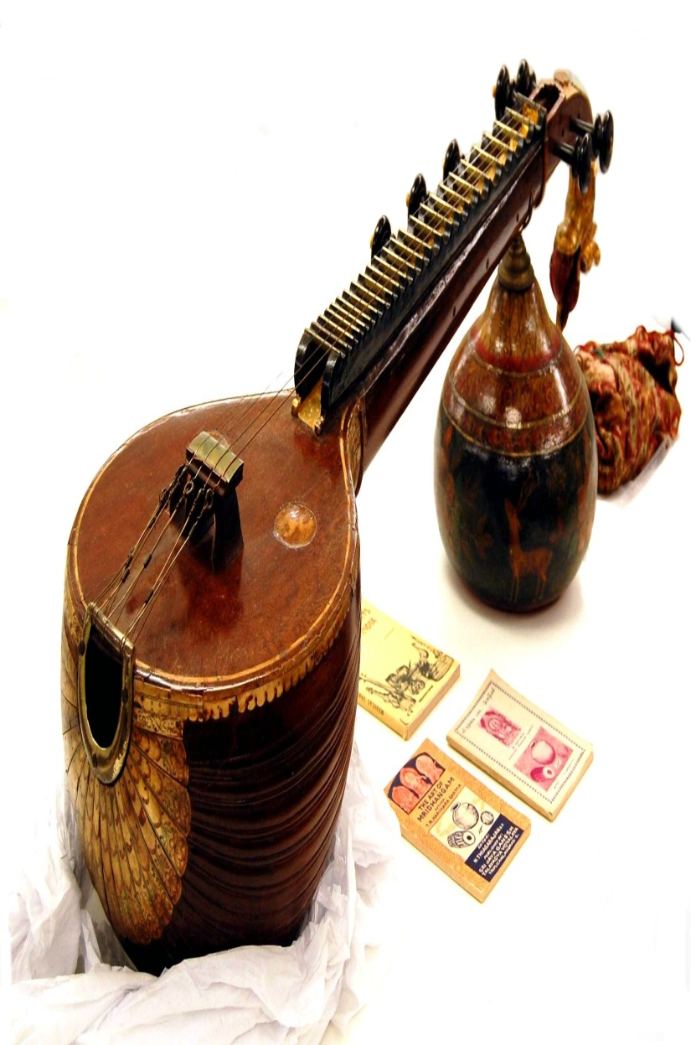
VINA
Along with the pakhavaj, the vina is one of the most commonly depicted instruments in Indian iconography. The vina has taken many forms in both South and North India. In North India, it was called the bin or the rudravina, and was the predecessor of the sitar. It was often built of two large gourd resonators connected by a piece of bamboo, with frets held on with wax. Most of the vinas depicted in iconography are rudravinas. In the South, the vina—or saraswati vina—continues to be the most popular stringed instrument in classical music. In its basic shape, the vina is a hollow wooden stringed instrument with two gourd resonators (though there can often be more than two or sometimes only one gourd resonator). The gottuvadyam, or chitravina, is another important instrument in Karnatak music. Unlike the rudravina and the saraswati vina, the gottuvadyam has no frets and is played with a slide using a method similar to that of the Hawaiian slide guitar.

Slide 64

TAMBURA
The tambura is a long, stringed instrument made of light hollow wood, with either a wooden or a gourd resonator. It is typically used in accompaniment with other instruments, providing a drone pitch. Some of the tamburas in the Museum’s collection are not full-sized instruments, but rather miniatures created for their aesthetic appearance. The artistic craftsmanship on the inlay in these objects is beautiful. India has a long history of creating musical instruments as decorative objects, and that tradition is represented in the Museum’s collection.

Slide 65

SETAR
The word setar means “three strings.” Other instruments in this family include the two-stringed dutar and the single-stringed ektar. As Indian musicians adopted the setar, they added more and more strings. Early sitars, which evolved from the setar, have six strings, while more contemporary ones include six playing strings and thirteen sympathetic strings. A Persian setar in the Museum’s collection is a miniature that was made primarily for the purpose of decoration. Many such instruments exist in India.

Slide 66

RABAB
The rabab is a stringed instrument with a skin-covered resonator that can be bowed or plucked depending on performance tradition. It is found in various forms throughout North Africa, the Near East, South Asia, and Central Asia. Similar to the way the setar and the vina were adapted to eventually become what is known today as the sitar, the rabab was adapted to become the sarod. However, there are many musicians in India today who still play the rabab, and it is quite popular in several music genres.

Slide 67

PAKHAWAJ
The pakhavaj is a barrel-shaped drum with two heads, each of which contains tuning paste, or siyahi. The history of the pakhavaj is unknown, yet as the predecessor of both the Hindustani tabla drums and the mrdangam of Karnatak music, it served as the primary accompaniment for much of Indian classical music. It appears in the musical iconography of Hindu religious painting and in the artworks of the royal Muslim courts of the Mughal empire.

Slide 68

MRADANGAM
The mrdangam is an elongated barrel-shaped drum found predominantly in South India (It is derived from the pakhavaj and is used as the primary rhythmic accompaniment in Karnatak music as well as in religious Kirtan music. In the east (Bengal, Odisha), this barrel-shaped drum is known as the khol.

Slide 69

KAMANCHE
The kamanche is one of the world’s earliest known bowed instruments. It has been altered and changed as it has traveled to other parts of the world . Some argue that the kamanche is the predecessor of many other stringed instruments such as the rabab, the sarangi, and the Chinese erhu.

Slide 70

KHANJAIRI
The kanjira is a frame drum of South India. It consists of a skin (usually iguana) stretched and pasted on a circular wooden frame. There are often three or four slots in the side of the frame, in which bell-metal jingle-disks are suspended from metal crossbars. The name kanjira is related to the khanjari and kanjani of North and East India and Nepal. The kanjira is tuned to various pitches by wetting the skin. It is held at the bottom of the frame by the left hand, which also varies the tension of the skin, and is beaten with the fingers of the right hand.

Slide 71

TAUS(MAYURI )
Popular at nineteenth century Indian courts, this bowed lute borrows features of other Indian stringed instruments, such as the body shape of the sarangi and the frets and neck of the sitar. There are four melody strings and fifteen sympathetic strings that sound when the instrument is played to accompany popular religious song. The peacock is the vehicle of Sarasvatî, the goddess of music, and it appears in Indian poetry as a metaphor for courtship.

Slide 72
Classification of Indian Musical Instruments - by Chaitanya Kunte
The pulse of nature is reflected in every movement of human beings. Human beings often express their feelings with body movements. After getting control over their body actions, humans started an articulated use of body gestures for expressing specific emotions such as joy, distress, grievance, etc. The rhythmic body movements such as clapping of hands, foot stomping, etc. made man to think of making percussion instruments. In the primary stage, man started making rudimentary percussion instruments, such as child's rattle. A burrow in the ground covered with skin made the elementary 'Dundubhi'. In the due process of advancement, man started making percussion instruments with wood, bamboo, animal skins, and metal.
In the NatyaShastra of Bharat Muni, the musical instruments are classified in four groups -
1. Tat Wadya: String instruments
2. Sushir Wadya: Blowing instruments
3. Awanadhha Wadya: Percussion instruments made with animal skin
4. Ghan Wadya: Solid instruments or Cymbals (A-tonal instruments) made by hard surfaces such as metal, wood, etc.

Slide 73

Classification of Indian Musical Instruments

Slide 74

1. String instruments - In the earlier stage, the strings were made up with weeds, animal skins, hair, etc. After the technique of making metal strings was invented, it made great advancement. Ancient mythology states that string instruments were formed by the bow of Shiva. One can interpret it as when the ancient man got to know the sound of bow string while releasing the arrow out of it, the idea of making a musical instrument might have struck in his head and then he made such bow shaped string instrument. The frequency depends upon the length of the string and also on the distance of the string from the sound bridge. After a lot of experimentation, man started making the ancient Veena, i.e. lute. The instruments such as Tanpura, Veena, Sitar, Sarod, Sarangi, Israj, Dilruba are string instruments. These string instruments are further divided into 4 categories -
a. Plucked instruments such as Tapnura, Swar-Mandal, etc.
b. Stroking instruments such as Sitar, Sarod, etc and
c. Bowed instruments such as Sarangi, Israj, Violin,
d. Hammered instruments such as Santoor.

Slide 75

2. Blown instruments - 'Sushir' means a hole, so the instruments having holes from which air is blown for sound production are called 'Sudhir Wadya'. These instruments have an air column made up with bamboo, wood or metal, to which there are holes for producing notes. The blown instruments are further divided into two categories -
a. simple blown instruments such as flute, Shankh, Tutaari,
b. blown instruments with reeds such as Shehnai, Sundri.

Slide 76

3. Percussion instruments - 'Awanadhha' means 'to cover over or conceal', so these instruments have a sound box with covering of skin. The 'Bhoomi Dundudhi' is the most ancient instrument of such kind. According to the making and playing technique, the percussion instruments are divided such as -
a. played with stroke of fingers such as Khanjira, Duff, Dimdi
b. played with stroke of a stick such as Dhol, Sambal, Nagada
c. played with the palms of both the hands, such as Pakhawaj, Mridangam,
d. played with a thread attached at the middle portion with holding at centre point, such as Damroo.
e. played with palms as well as fingers, such as Tabla, Dholki, Dholak.

Slide 77

4. Solid instruments - 'Ghana' means solid, so these instruments are solid in state, not hollow in shape. These instruments are made with a variety of materials such as stone, bones, horns, wood, metals, etc. These instruments are further classified in 3 groups. They are as follows -
a. played with contact, such as Chipli, Taal
b. played with a stick or hammer, such as JalTarang, KaashthaTarang, Ghanta
c. played with rotation or free movement, such as Ghunghroo, Ghantika, Rattle, Kabas, etc.
Though they have attractive tonal quality, these solid instruments are basically a-tonal, i.e. they cannot produce various note on the same instruments, so they are used for maintaining the tempo or rhythm. So, one can find the use of solid instruments in other genres such as folk, film music, applied music rather than in classical music.

Slide 78


Modern era with the advent of some new instruments in India, two new categories are added to these traditionally accepted four categories -
a. Key board instruments - such as Harmonium, Organ, Piano, which are basically European instruments
b. Electronic instruments - we have many electronic musical instruments, including electronic Tanpura, electronic Tabla and so on.

Slide 79


